Slide 1
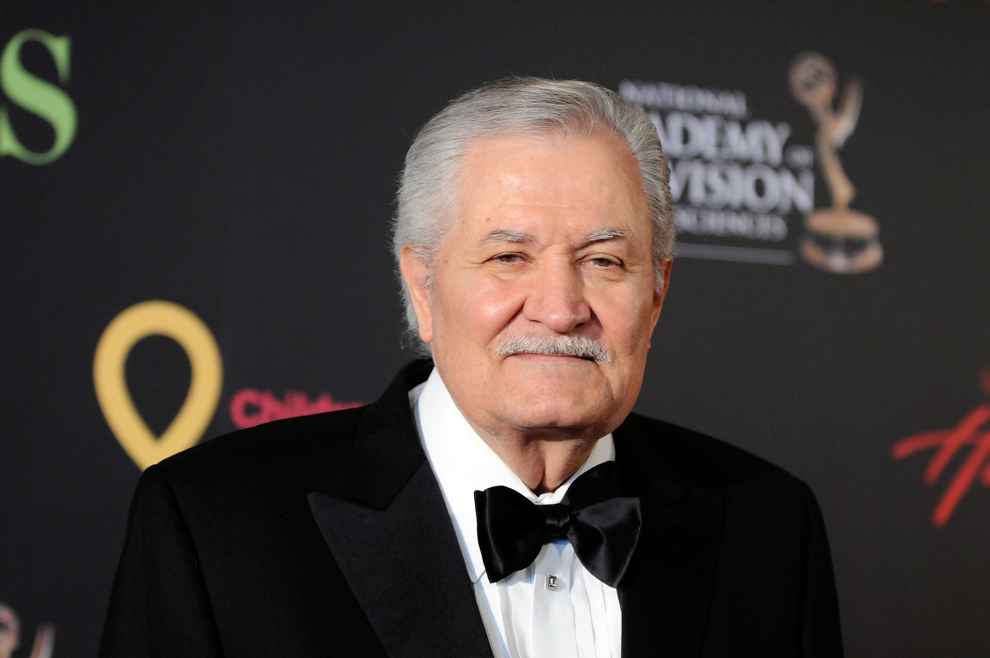
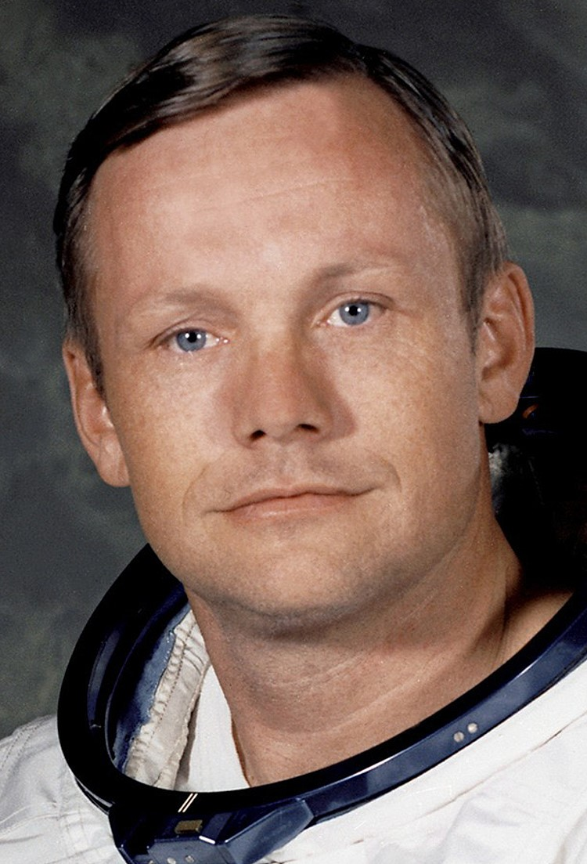
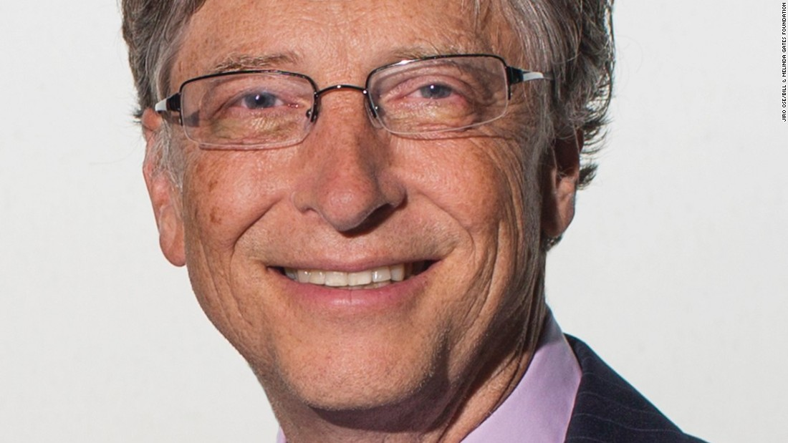
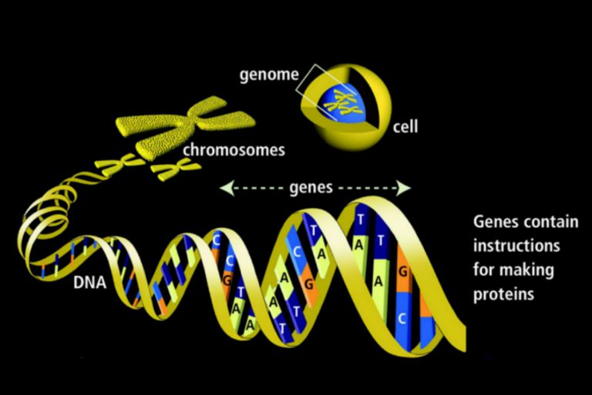
Key Figures & Quotes
John F. Kennedy
Set the Moon landing goal (1961 Rice speech). Catalyzed Apollo funding, schedule, and national focus.
Quote: We choose to go to the Moon in this decade and do the other things, not because they are easy, but because they are hard.
Neil Armstrong
Commander, Apollo 11; first human on the Moon. Test pilot; Gemini and Apollo astronaut.
Quote: That’s one small step for [a] man, one giant leap for mankind.
Bill Anders
Apollo 8 astronaut; captured the iconic Earthrise photo. Helped shift public perspective to a fragile Earth.
Quote: We came all this way to explore the Moon, and the most important thing is that we discovered the Earth.
Gene Cernan
Apollo 17 commander; last human to walk on the Moon (1972). Geology-focused exploration with Harrison Schmitt.
Quote: We leave as we came, and, God willing, as we shall return, with peace and hope for all mankind.

